Slide 1
EE 295
Tech Writing-Engineering Ethics
Sep 5, 2019
Room E 339
Tom Wrappe
EE Lecturer

Slide 2
-Tech Writing
-Structure and Outline
-EE 295 Milestones
-Midterm Topic Discussion
-Plagiarism
-Next Class

Slide 3
Adaptable Black Box Approach to Tech Writing Process
Content
Clear Conclusion
Concisely Stated
Well Supported
6 Edit
2 (Ideas), 3 (Organize), 4 (Sequence)
Generate Technology
Document
(FPGA)
5 Draft
EE 295 Rules
Rules
Grammar
295 No No’s
Plagiarism
Inputs
Step 1: Configured to Meet type of Document
-Product Description
-Patent application
-Business Case
-Research Paper
(Firmware)
Output
Metrics

Slide 4
Six Step Method to Reader Centered Writing
Step 1 Analyze your purpose and audience by using the Focus Sheet
Step 2 Generate Ideas by using a start-up strategy
Step 3 Organize your information
Step 4 Sequence your ideas. The bottom line should go on top– most of the time
Step 5 Write the first draft
Step 6 Edit for clarity, conciseness and accuracy

Slide 5
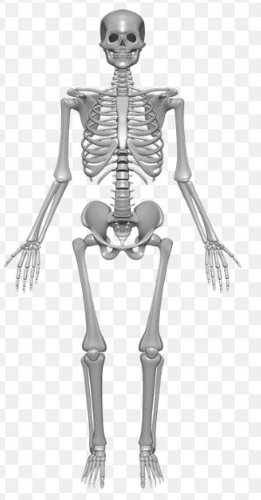
Structure is all about Good Bones

Slide 6
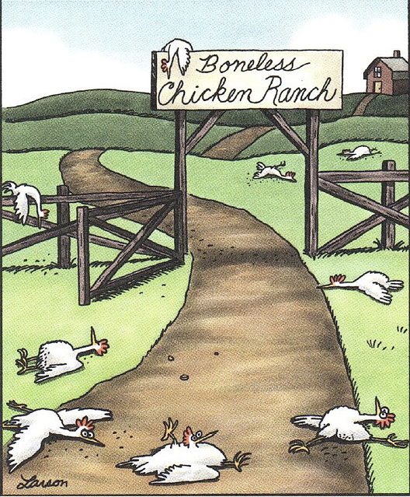
Without structure, you have a mess….
Boneless Chicken Ranch, The Far Side, Gary Larson, published Jan 2, 2013

Slide 7
A Complete Outline
Summary/Purpose
Introduction
Methods, Assumptions, and Procedures
Results and Discussion
Conclusions
Recommendations*
References
Note: Contents of the boxes can be combined in short papers

Slide 8
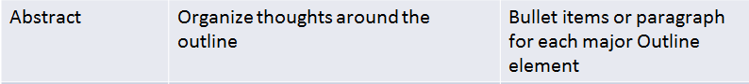
Progressive Overall Structure

Slide 9
Paragraph Construction: The Basic Building Block of Successful Papers

Slide 10
EE 295 paper checklist
Use of personal words
(such as I, we, me, mine, our, ours, let’s (let us), us, you, your, he, she)
2. lists (put all materials in tables) Do not assume reader viewed the table
3. Any occurrence of ‘nothing but’, ‘little more’ or ‘nothing more’
4. “Of the” , “by the”, “in the”any text followed by ‘:’ except when introducing a figure, table, or code block.
5. Questions in titles/headings
6. Text that depends on the title/heading for reading correctly
7. Unsupported conclusions
8. One line paragraphs
Code, algorithms, formulas, or figures with little or no explanation. Write more prose than code explaining function
All code, lists, algorithms must be in tables
11. Singular/Plural mismatch. Words do not match in sentence. Verb does match noun or object.
12. Any use of ‘very much’ , ‘very many’, ‘very little’, ‘more better’, ‘more worse’, ‘very very’ etc…
13. Wordy phrases like ‘it can help the user to analyze the usage of application’ should be ‘it helps the user analyze application usage’
14. Tense shifts from past, present, and future in the paper. (Unless describing historical and now current topics)

Slide 11
Semester Major Items…..(subject to modification)
 | Mid Term | Resume | Final Paper | Final Presentation (slides )
Topic Paragraph | 9.5.19
Topic Proposed | 9.12.19 |  | 10.3.19
Topic Final | 9.19.19 |  | 10.10.19
Outline/ Abstract | 9.26.19 |  | 10.31.19
Research | 10.1.19 | 10.24.19 (Class) | 10.15.19
Draft Complete | 10.10.19 |  | 11.7.19 | 11.19.19
Final Submit | 10.22.19 | 11.14.19 | 11.26.19 | 12.3.19
Final Presentation | NA | NA | NA | 12.17.19 (Sect 1) 12.12.19 (Sect 2)

Slide 12
Group Discussions
Form up groups of 3 or 4
Discuss current thoughts on Midterm topics (due Sep 12)
Area of technology you are considering
Product area
Why you think this is a good topic/area
Pick one person from the group to provide basic area if the group is called on

Slide 13
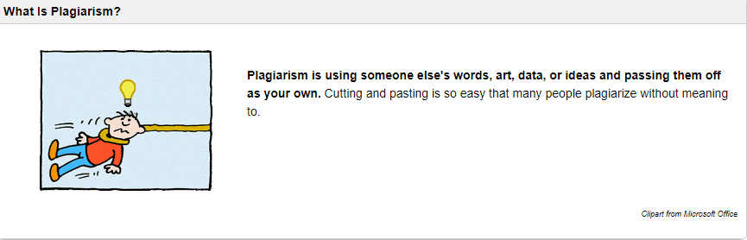
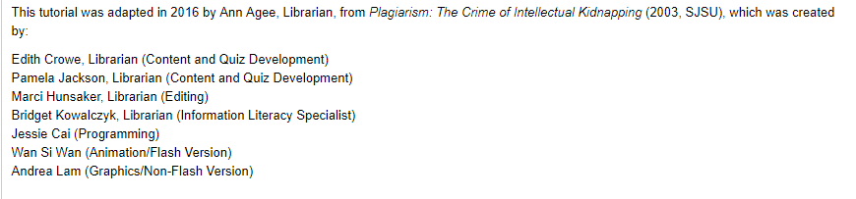
What is Plagiarism?

Slide 14
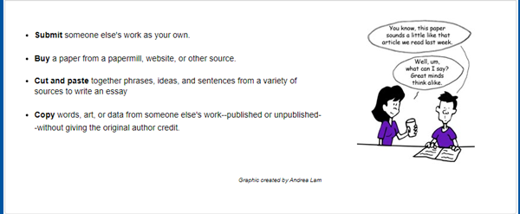
You might be Plagiarizing if you..

Slide 15
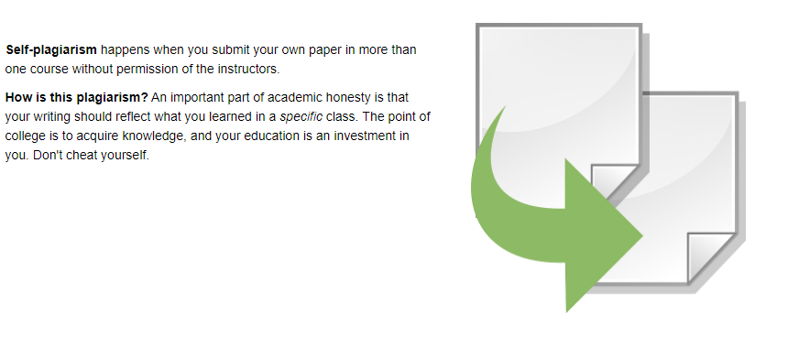
Self Plagiarism….

Slide 16
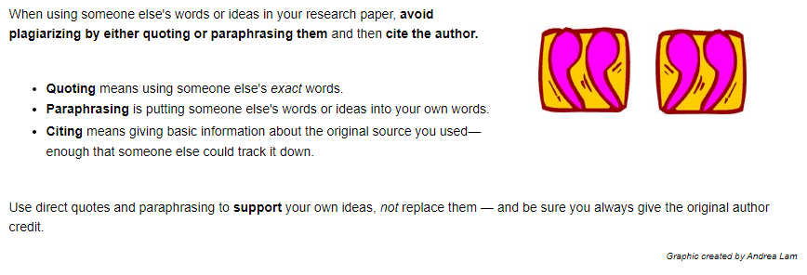
How to Avoid Plagiarism

Slide 17
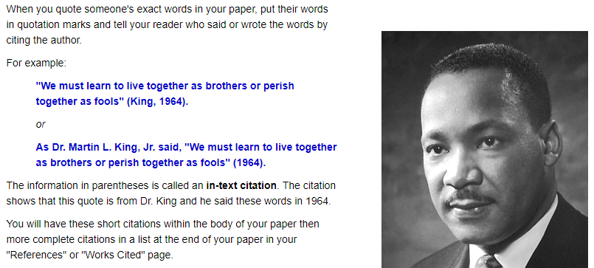
Quoting

Slide 18
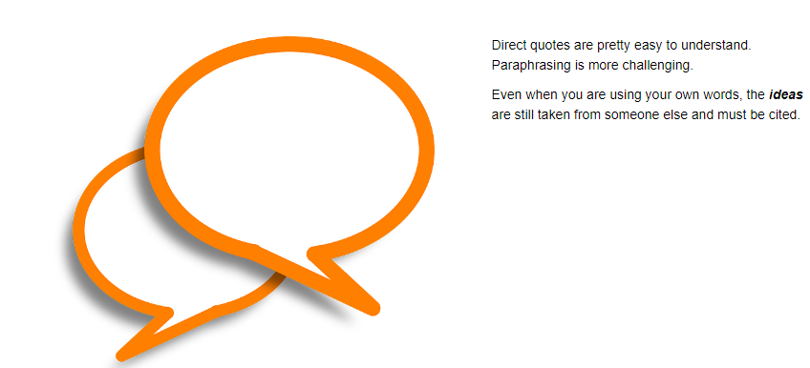
Paraphrasing

Slide 19
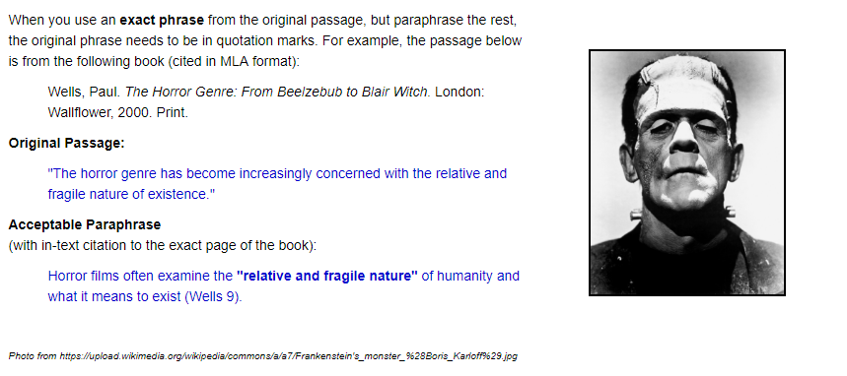
Paraphrasing: Some Details

Slide 20
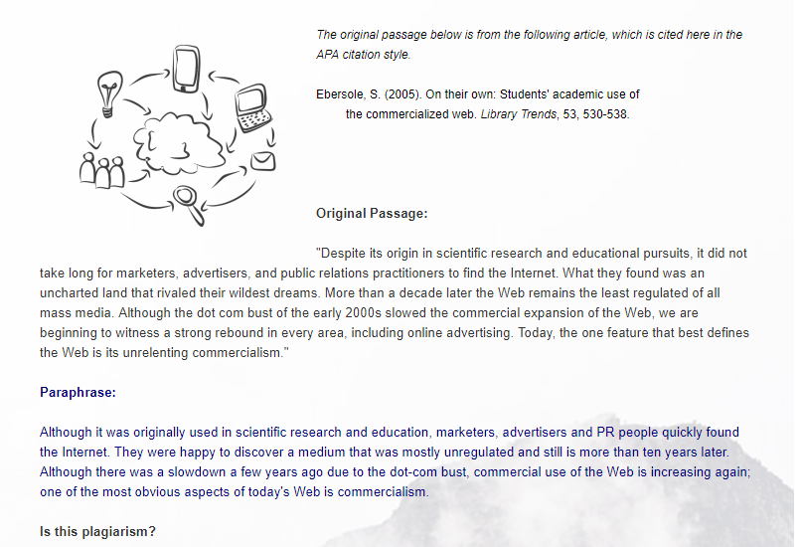
Is this Plagiarism?

Slide 21
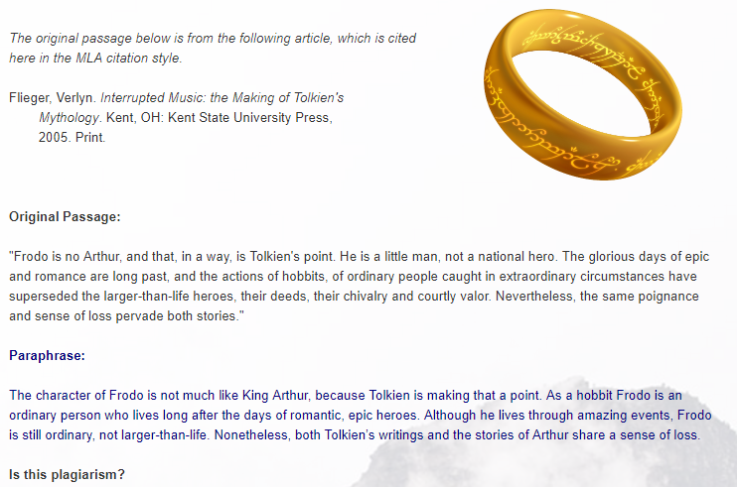
How about this?

Slide 22
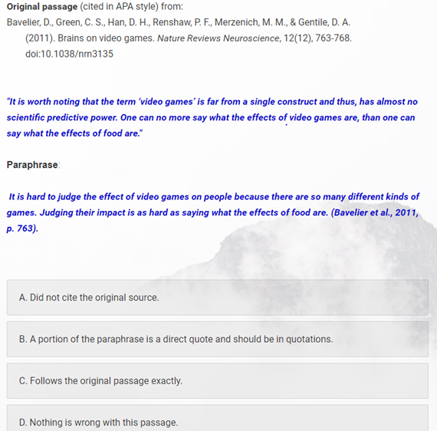
Is anything wrong here?

Slide 23
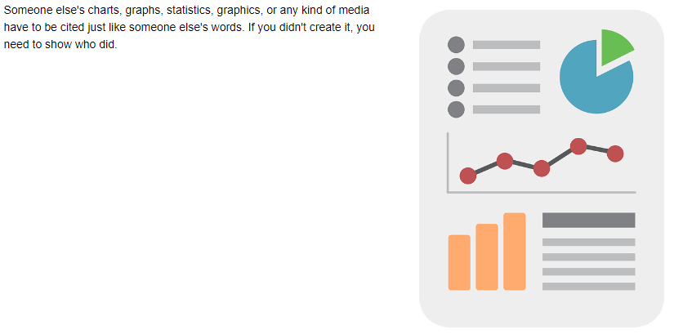
How about Charts and Graphs?

Slide 24
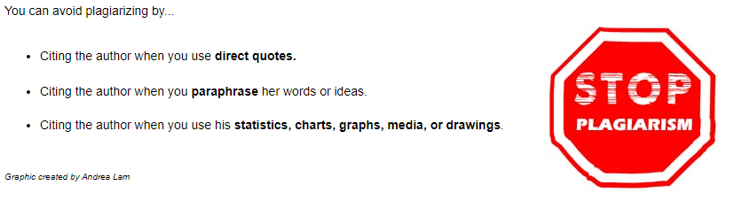
Citing

Slide 25
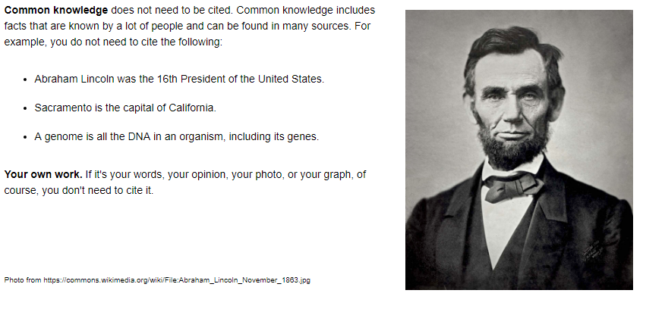
What does not need Citing?

Slide 26
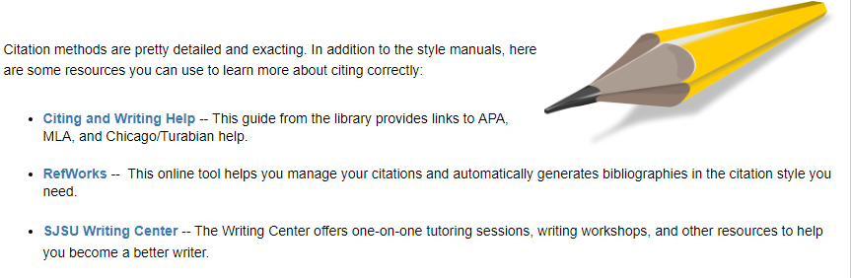
Citation Sources

Slide 27
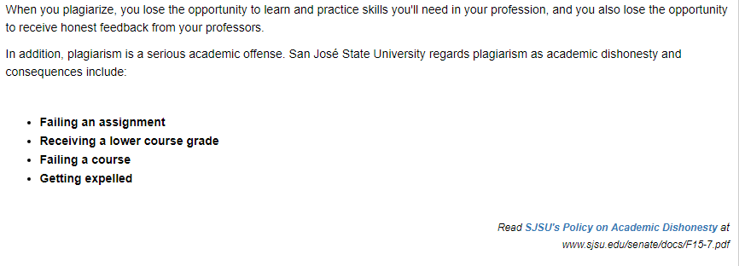
Consequences of Plagiarism

Slide 28
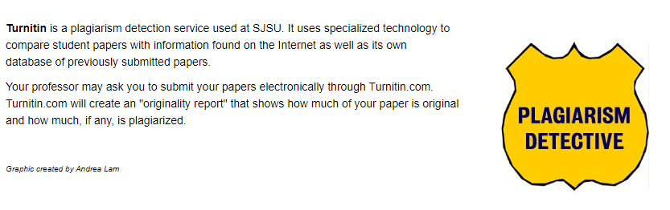
Who will know?

Slide 29
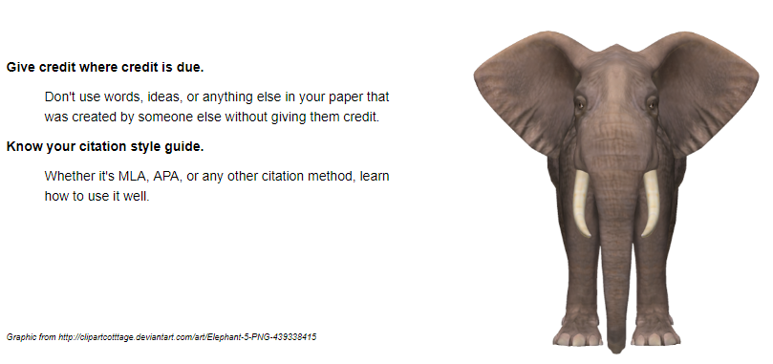
Remember to…

Slide 30
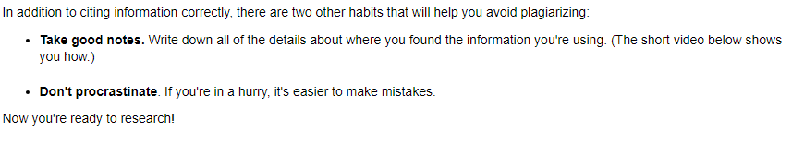
Two more things…
Video on Avoiding Plagiarism can be accessed at
http://libguides.sjsu.edu/plagiarism/two-more-tips

Slide 31
Take the Online Exam
http://libguides.sjsu.edu/plagiarism/test-for-class-credit

Slide 32
If you need help on Turnitin (TII)
https://help.turnitin.com/new-links.htm

Slide 33
Discussion Exercises
Out of class writing exercise #1: Differences between Engineering and Science

Slide 34
Out of class writing exercise #1: Differences between Engineering and Science (Content)
Criteria | Examples | Comments
[a] Clear Conclusion | Science and Engineering share many of the same tools, but have many differences in their fundamental goals and motivations | -State early in the document -Summarize in different words at end of the document
Concisely Stated | One page, approx 600 words is sufficient | Don’t write “filler” that goes beyond the instructions and make the paper repetitive. Choose powerful macro examples to back up your assertions.
Good Flow | 4 or 5 Good paragraphs with solid structure -Introductory Statement/Conclusion -How Science and Engineering Differ (with support) -How Science and Engineering Share common elements (with support) -Conclusion | -Each paragraph should have one unique topic sentence ‘---UNDERLINE in all submissions. -Non topic sentences support the topic sentence +Body sentences +Conclusion sentence finishes the paragraph
[b] Strongly Supported | -Provide actual concrete examples of where science and engineering differ -Goal of engineering is improvement, while science is seeking knowledge -Starting point of engineering is a problem, while science starts with a thesis | -Supporting elements for each assertion -Summarize the contrast between science and engineering and restate/reinforce the conclusion

Slide 35
Out of class writing exercise #1: Differences between Engineering and Science (Grammar)
Criteria | Examples | Comments
Grammar | Use the EE295 checklist as a point of reference
-No personal pronouns | I, me, it, they | All can be ambiguous . Use descriptive nouns, like “the bridge” or “the project” to make reference. No place for personal pronouns –stay to 3rd person. “It” is especially ambiguous. Only use when absolutely clear what “it” is…
-Small Paragraphs | Conclusion is a full paragraph, not two sentences | Have one topic sentence per paragraph. For a well constructed paper, you should be able to read only the topic sentences and see the flow of the paper.
-No passive statements | Avoid “was done” or “were deduced”…. | Say “Scientists develop theories…” or “engineers develop products”
-Articles | Use The, a, an, properly
-Complete Sentences | Always have a subject and an object | “whereas” is a sentence connector, not a verb
-Plagiarism | Need to run check to keep target of less than 15% | Turnitin provides feedback

